Slide 1

Bellabeat Case Study
Google Data Analytics Capstone
Presented by: Akshat Sharma
Last modified: 31-08-2025
Tools Used: MySQL · Tableau · Excel

Slide 2
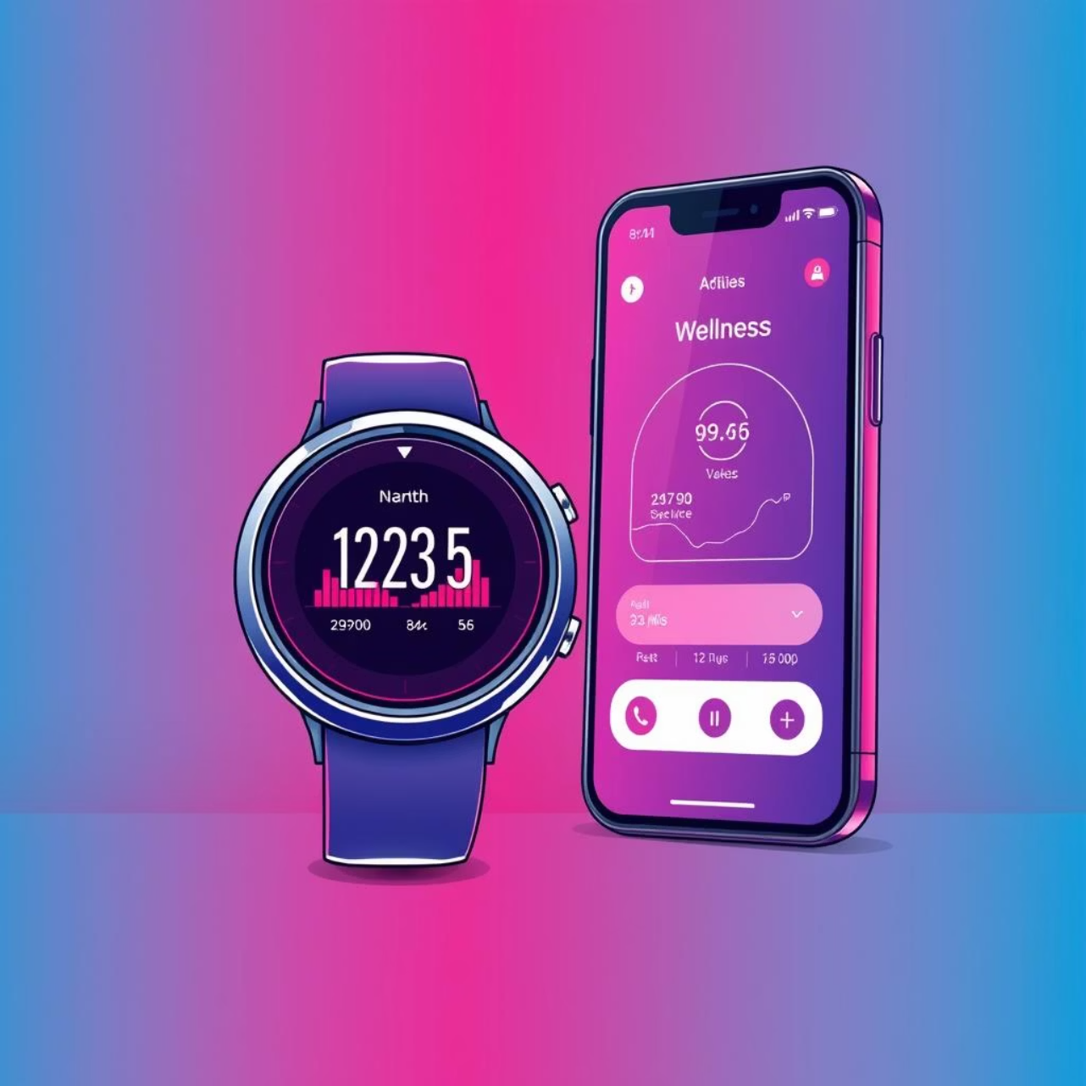
Business Context
Bellabeat is a wellness-focused tech company aiming to improve marketing for its smart watch, Bellabeat Time.
As a junior data analyst, I was tasked with analyzing Fitbit usage data to uncover behavioral trends and inform strategy.

Slide 3
Business Questions
Usage Patterns
Activity Relationships
User Engagement
How do activity levels relate to calorie burn and sleep quality?
When and how should Bellabeat engage users for maximum impact?
What are the key usage patterns in daily activity and sleep?

Slide 4
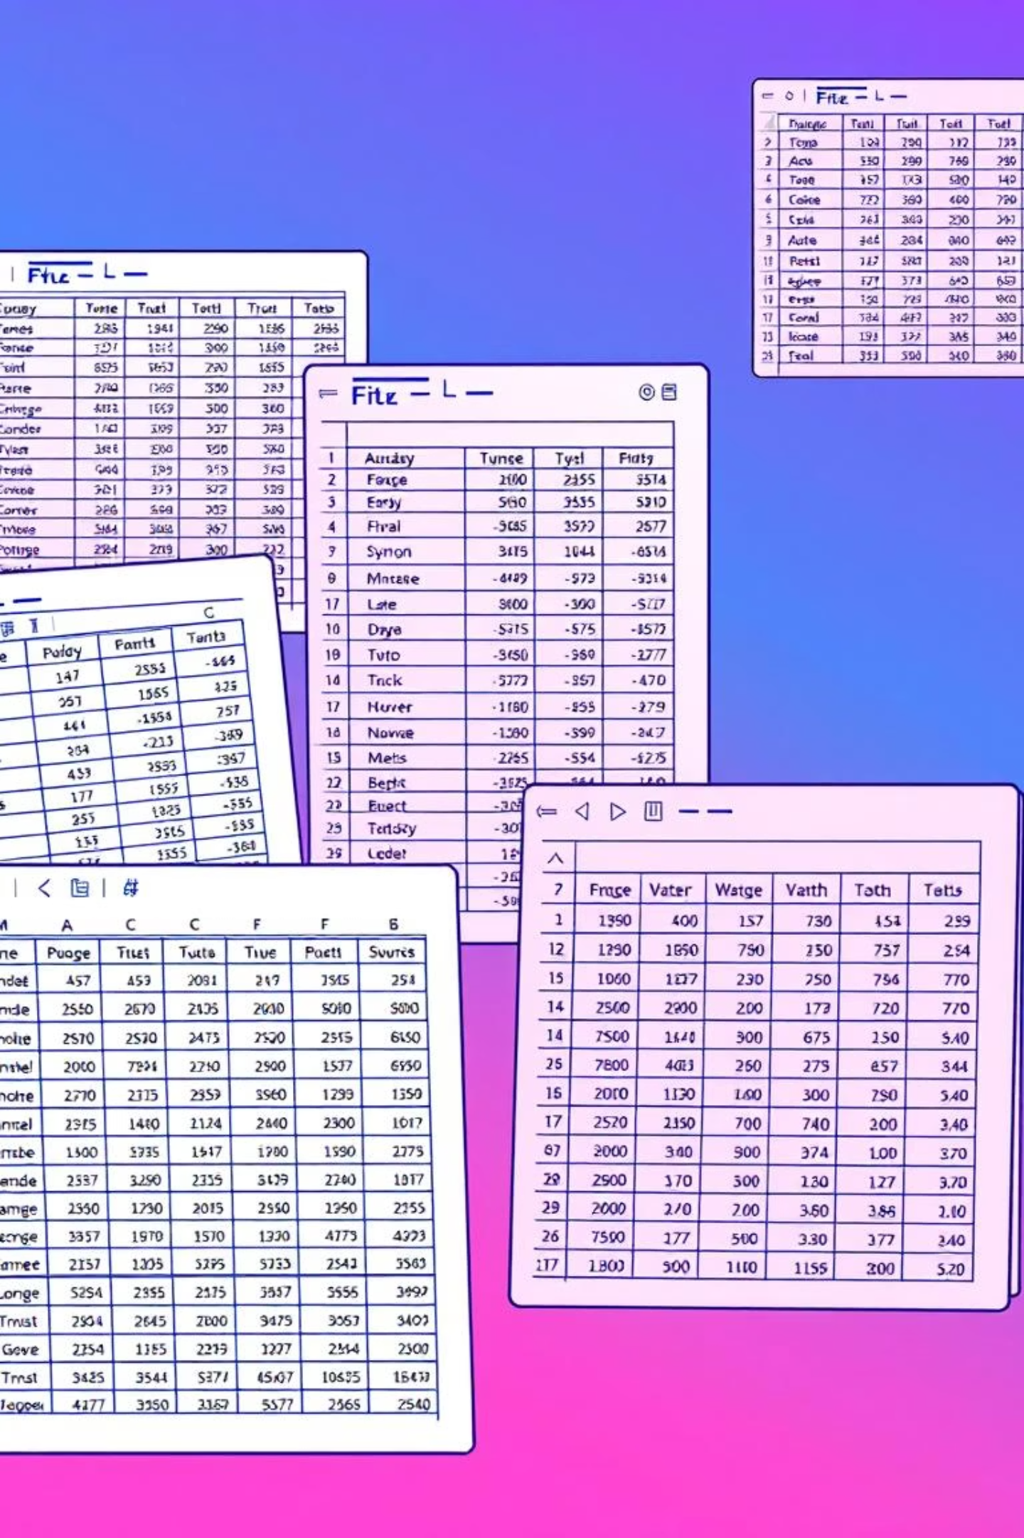
Data Sources
Raw Excel files
Issues
Daily activity, sleep, and calories
Inconsistent date formats, mixed time formats, type mismatches
Solution
Imported using VARCHAR(50) into MySQL for flexible cleaning

Slide 5
Data Cleaning Strategy
2.Standardize
1. Import
Standardized dates (YYYY-MM-DD) and times (HH:MM:SS)
Created raw tables for import
4. Convert
3. Create
Created clean tables: cleaned_dailyactivity, cleaned_steps, cleaned_sleepday
Converted fields to appropriate types (INT, DECIMAL, DATETIME)

Slide 6
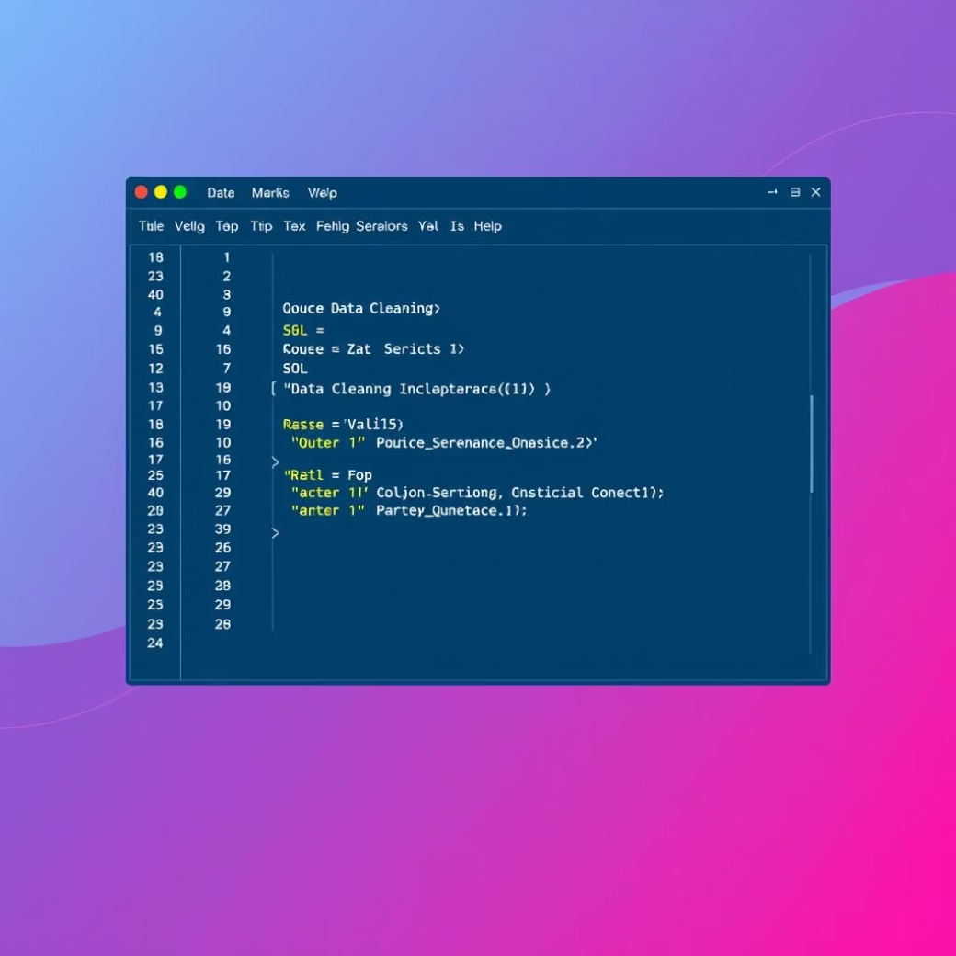
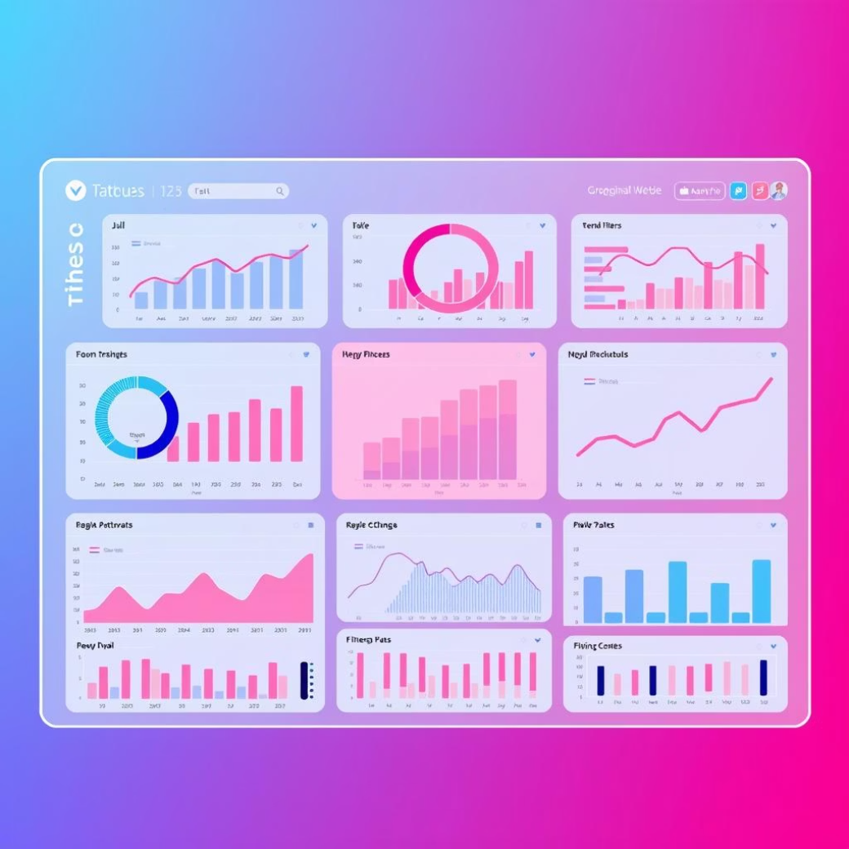
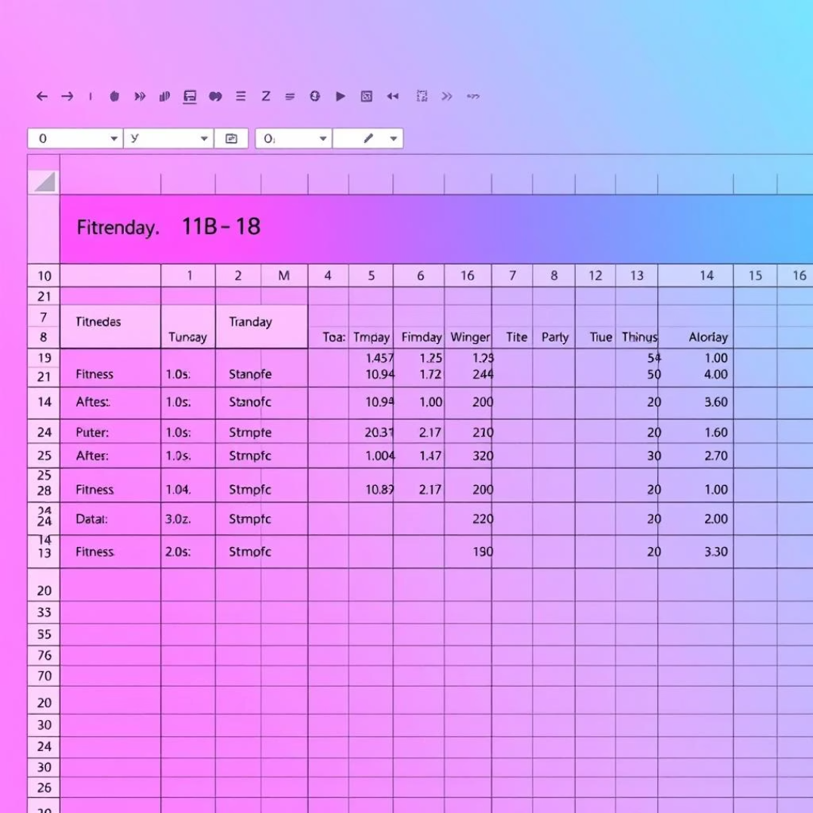
Tools Used
MySQL
Tableau
Excel
Data cleaning and transformation
Visualization and dashboard creation
Initial exploration and formatting

Slide 7
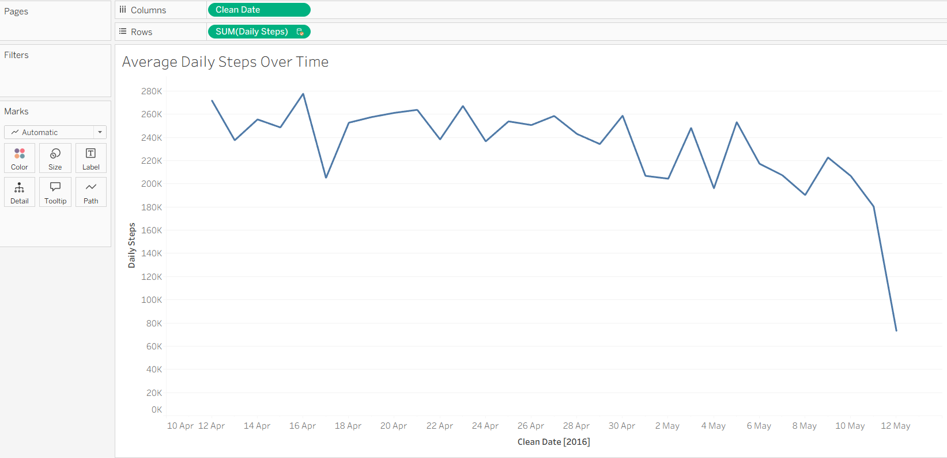
Key Visuals – Steps Over Time
Average Daily Steps Over Time
Shows fluctuations in physical activity with a sharp decline around May 10, 2018—potentially indicating behavioral shifts or device drop-off.

Slide 8
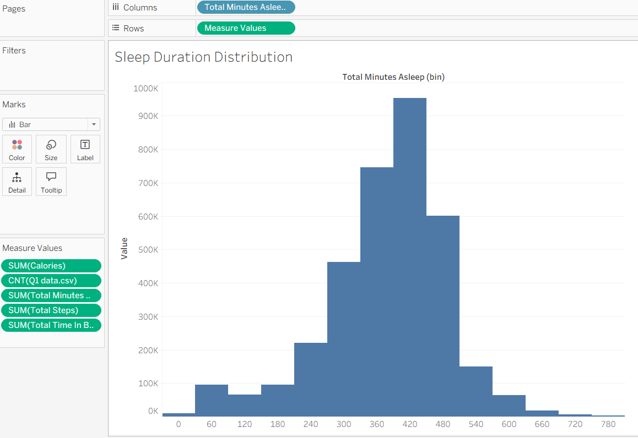
Key Visuals – Sleep Distribution
Sleep Duration Distribution
Most users sleep around 420 minutes (~7 hours). Distribution reveals outliers and potential sleep inefficiencies.

Slide 9
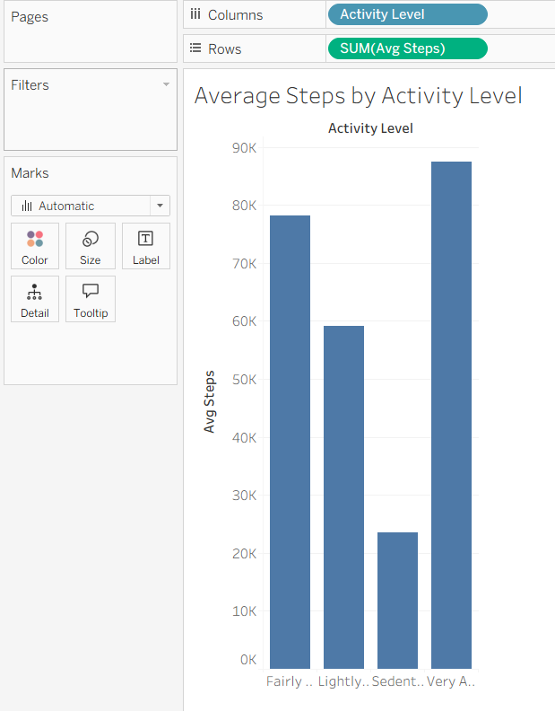
Key Visuals – Activity vs Calories
Steps vs Calories Burned
Strong positive correlation between physical activity and energy expenditure. High-step users consistently burn more calories.

Slide 10
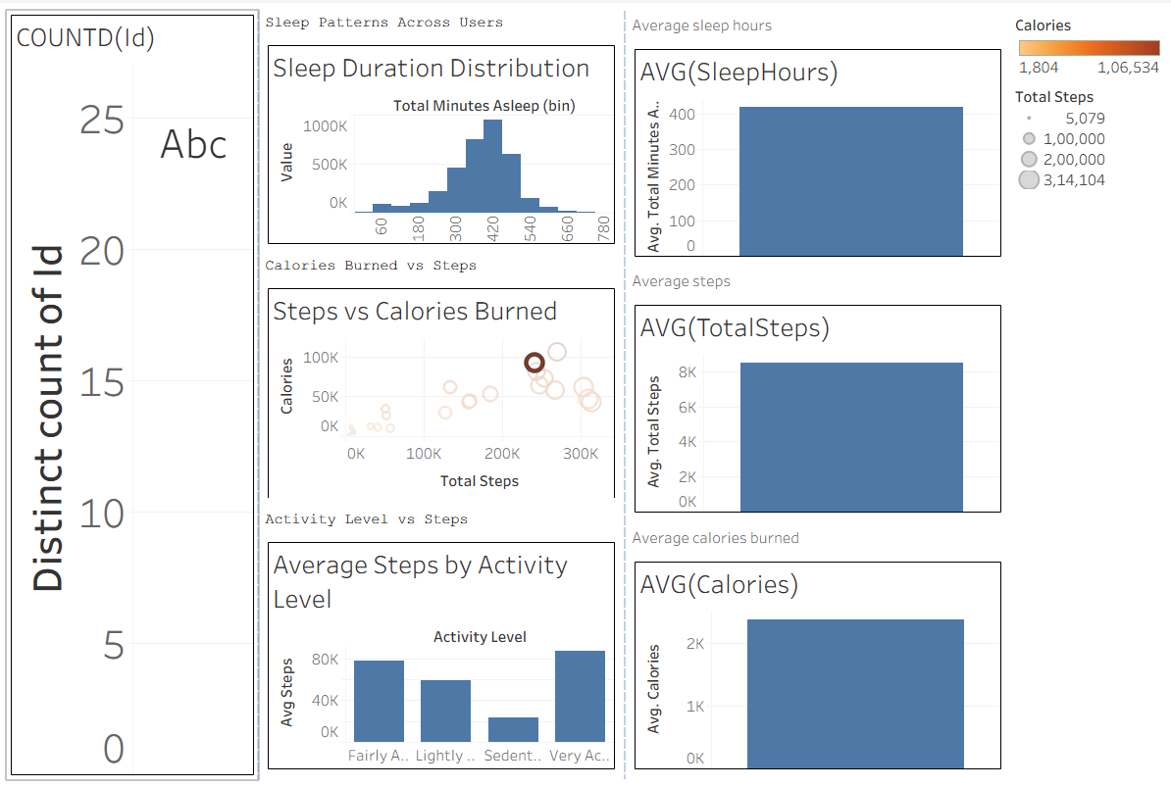
Dashboard Overview
Bellabeat Tableau Dashboard
Combines sleep, steps, calories, and activity levels into one interactive view. Enables cross-metric analysis for marketing decisions.

